Slide 1
Causal and statistical inference
What is missing, what is desired?
Counterfactuals?
Missingness | No | Yes
No | Complete information | Finite sample causal inference (Fisher)
Yes | Standard statistical inference “to the population” | Sample & assignment selection (Neyman, Rubin)
Units?

Slide 2
Y_{OBS} = Y₀+(Y₁ – Y₀)E
Y₀
{X : E (Y₀, Y₁) | X}
{X : E (Y₀, Y₁) | e(X)}
B
T
Y
Y₁
blocking can (e.g. regression, matching,…)
reduce bias
reduce noise
explain heterogeneity.
Notes:
Y_{OBS} = Y₀+(Y₁ – Y₀)T within strata of X where,
i

Slide 3
Y₀
n
s
U_{Y}
T
Y
Y₁
blocking can (e.g. regression, matching,…)
reduce bias
reduce noise
explain heterogeneity.
Notes:
signal/noise
n = noise, or residual variation between units outcome, unexplained by treatment (in a structural generative model, variation in this dimension comes from exogenous U_{y}).
s = causal effect of treatment.
Pretreatment variables block backdoor (bias) and front door (variance).

Slide 4
Y₀
n
s
B
T
Y
Y₁
blocking can (e.g. regression, matching,…)
reduce bias
reduce noise
explain heterogeneity
Notes:
Blocking does all of these things, for either same or different pretreatment variables.

Slide 5
Bias (sampling & assignment)
Y₀
Y₀
Y₁
Y₁
Fisher but Simpson, Neyman but Berkson
Actually, this should be a 2 x 2 table of graphs (with/without each bias).

Slide 6
Correlation and causation in social genomics
Justin Chumbley
Notes:
Motivate causal inference. Policy.
- Ideal outcome of DE, or DEGS, is an non-zero association between exposure/expression.
- A positive correlation, is consistent with positive causation, zero, or negative causation, i.e. have no idea unless causation is identified.
- If you care about policy, there is no avoiding this.
This involves being more careful about what causation is – in particular I discuss the structural and non-structural counterfactual - but I have attempted to create a cartoon guide as I knew this was to take place at 8.30 am.
You cannot do inference without assumptions, causal inference entails the conditions/assumptions needed for a causal conclusion.
I want to move toward a more explicitly causal discussion of social genomics. Concerned with defining non/structural PO, identifying bias/identification in causal inference (confounding, selection, measurement) – total and path-specific - and causal structure learning (not statistical precision/prediction). Thus tension with predictive research
No trading bias for variance (no James-Stein, shrinkage, etc): “consistency before efficiency” (although this is overstated, we must always make simplifying assumptions with bias).
Underfitting/overfitting.
Variance and bias reduction.
Intrepidation: Hard to talk about causality because many qwirks, econ, stats, have different jargon. Causal assumptions often implicit in genomic, e.g. because assumed that people are dealing with randomized controlled experiments. In non-randomized studies, we must be explicit. The good news is the underlying concepts are simple and related.
I will take a historical perspective and rehearse
what is special about RCTs, only their qualitative identification assumptions.
their limitations, no mediation: even with randomization!
Without RCTs? total and path-specific effects?
Defensible assumptions, encoded intuitively (DAG).
Rests on sequential ignorability or unconfoundedness.
Sensitivity.
I will look at definitions & identification, not derive estimators/inference.
Sequential ignorability in gene expression. Multilevel mediation.
I assume biological and social causality follows the same definition.
Brain-mediated social immune response
cognitively-mediated NP effects
Observed/Potential DE
Endogenous dynamic treatment
- Treatment related to factors that would effect potential outcome anyway (even had treatment been fixed).
Child’s stress-reactivity impacts both parental treatment and the potential biological outcome.
Multiple mediation (environmental, non/central)

Slide 7
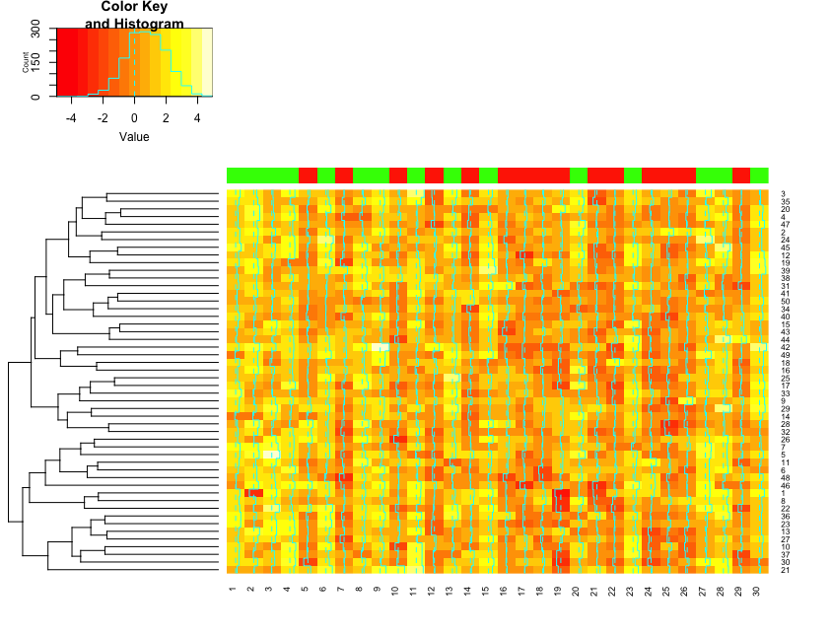
Gene expression

Slide 8
Dogma of statistical inference: y ~ P
Gene expression

Slide 9
Counterfactual gene expression.
Dogma of statistical inference: (y,t) ~ P
Exposure
Gene expression
Notes:
P(G)
P(H)
P(G, H)
P(Y|t) DE analysis
P(T|y) Prediction
Traditional pre-occuptions: mutual information, statistical relationships.
Differential expression
High-dimensionality (bias from over-fitting).

Slide 10
Counterfactual gene expression.
Dogma of statistical inference: (y,t) ~ P
P(T)
Exposure
P(Y, T)
Gene expression
P(Y)
Notes:
P(Y|t) DE analysis
P(T|y) Prediction
Traditional pre-occuptions: mutual information, statistical relationships.
Differential expression
High-dimensionality (bias from over-fitting).
P(G, H) contains policy information? Under what conditions.

Slide 11
Counterfactual gene expression.
Dogma of statistical inference: (y,t) ~ P
P(T)
Exposure
P(Y, T)
= P(Y)P(T)
Gene expression
P(Y)

Slide 12
Counterfactual gene expression.
Exposure
Gene expression
Notes:
Cause of differential expression?
Total treatment effect.
This is the “black-box” realm of classical RCTs.

Slide 13
Counterfactual gene expression.
Exposure
M
Gene expression
Notes:
Two ways to refine causal description
Split a node/variable
Split an edge: causal vs statistical mediation.
Environmental/Brain/Cognitive/Molecular mediators (KEGG DAGs)/molecular transcription factors (TELIS)

Slide 14
Counterfactual gene expression.
Exposure
M
Gene expression
Disease

Slide 15
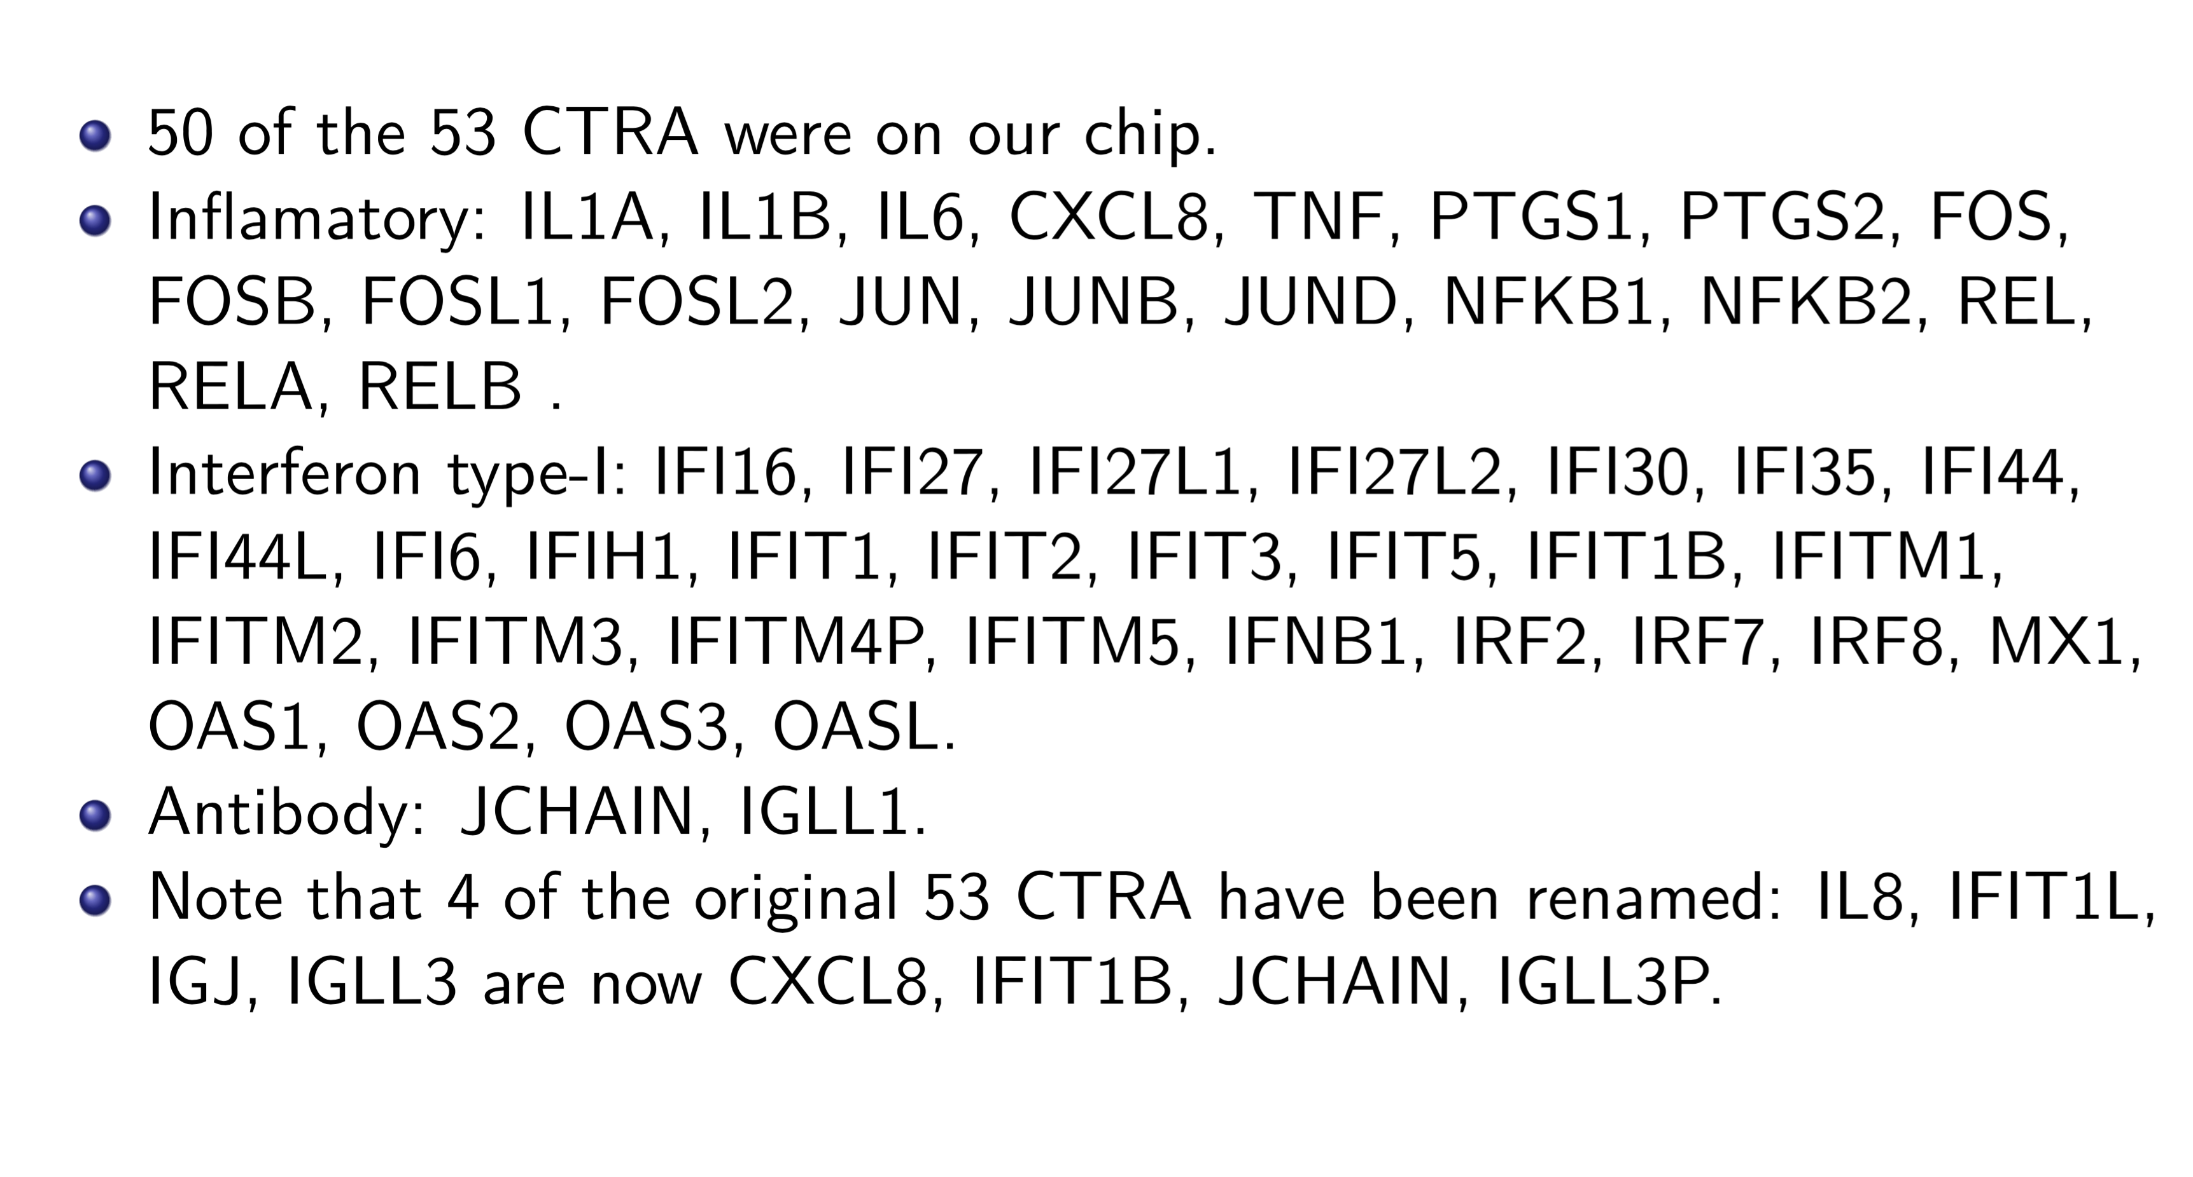
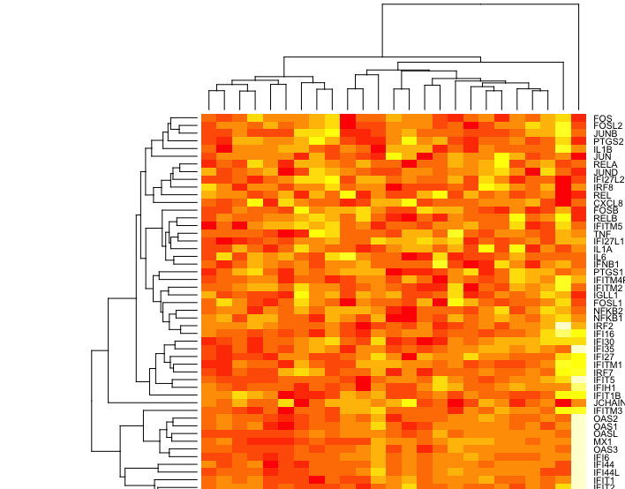

Slide 16
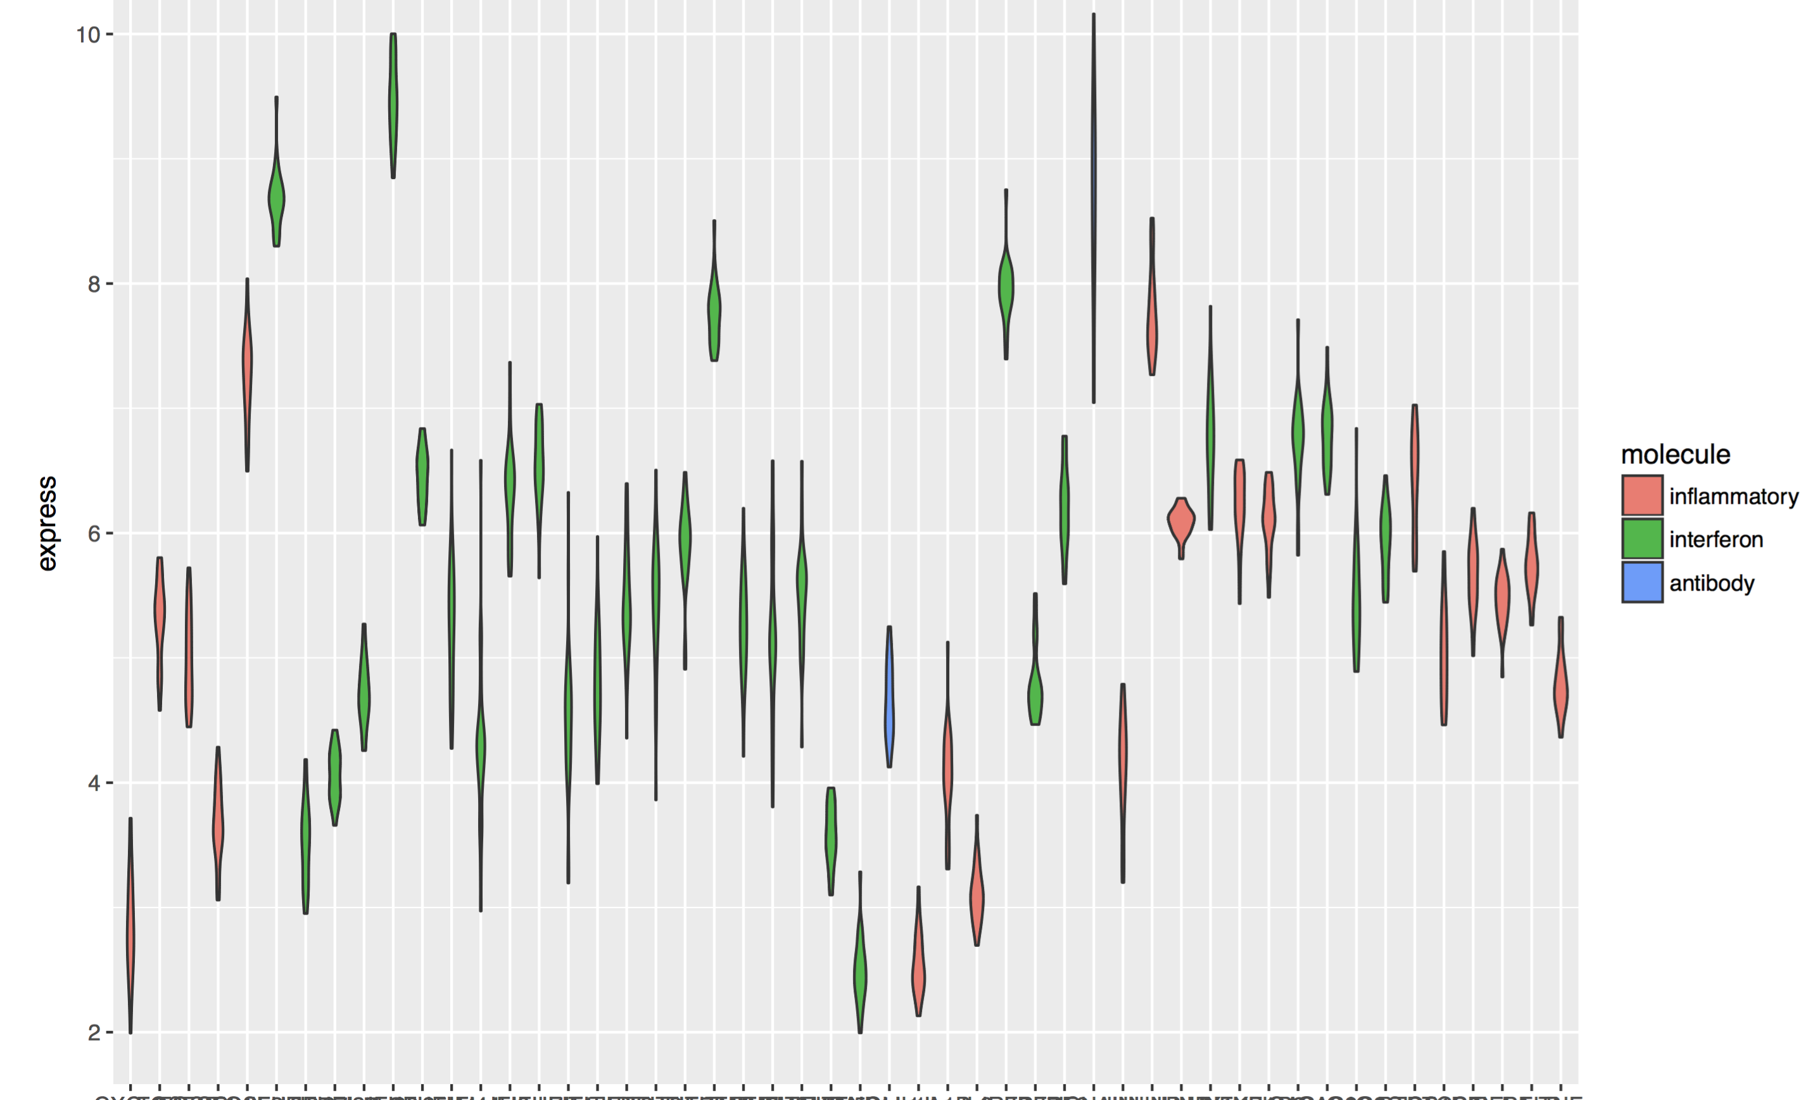

Slide 17
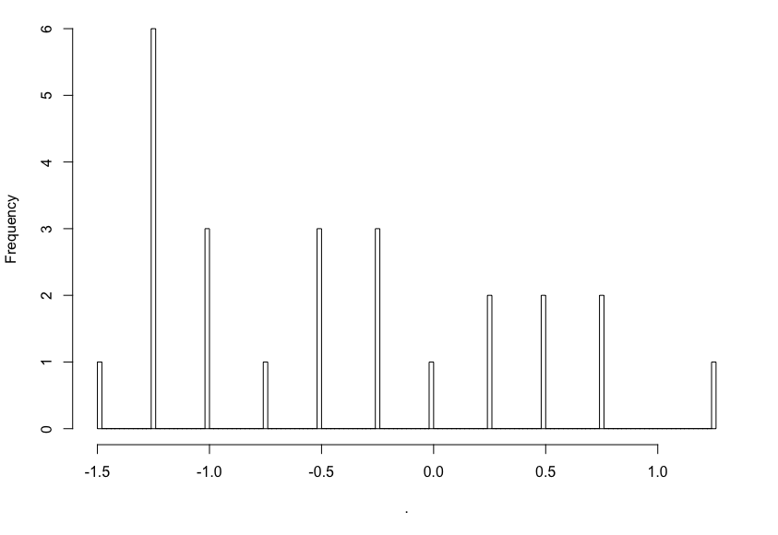
Chen

Slide 18
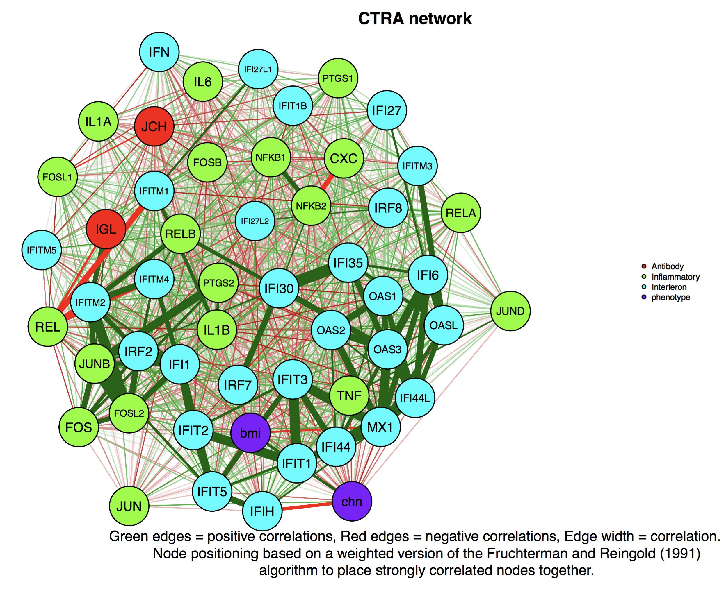

Slide 19
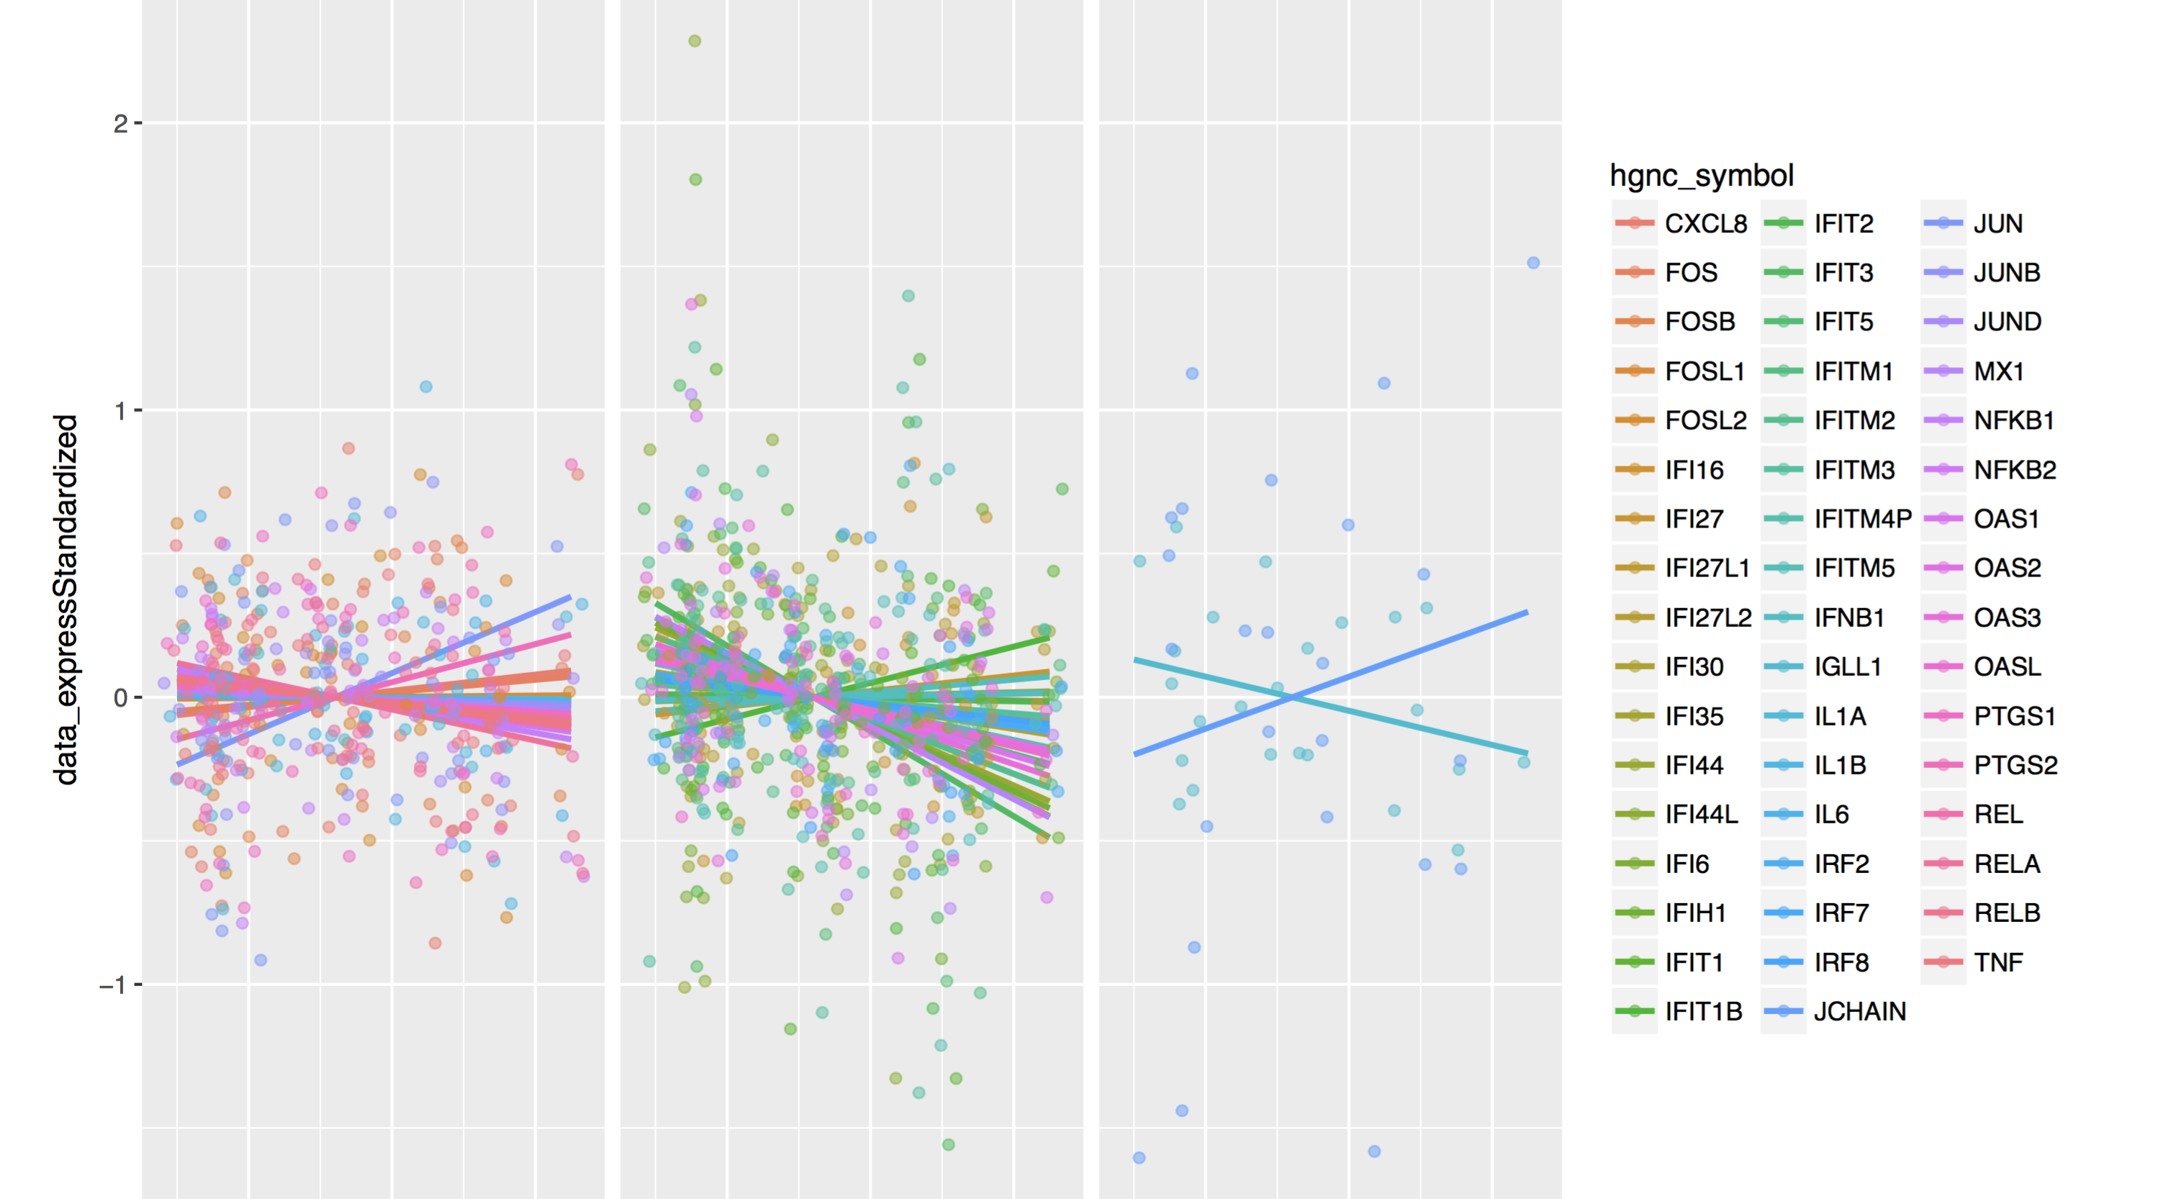

Slide 20
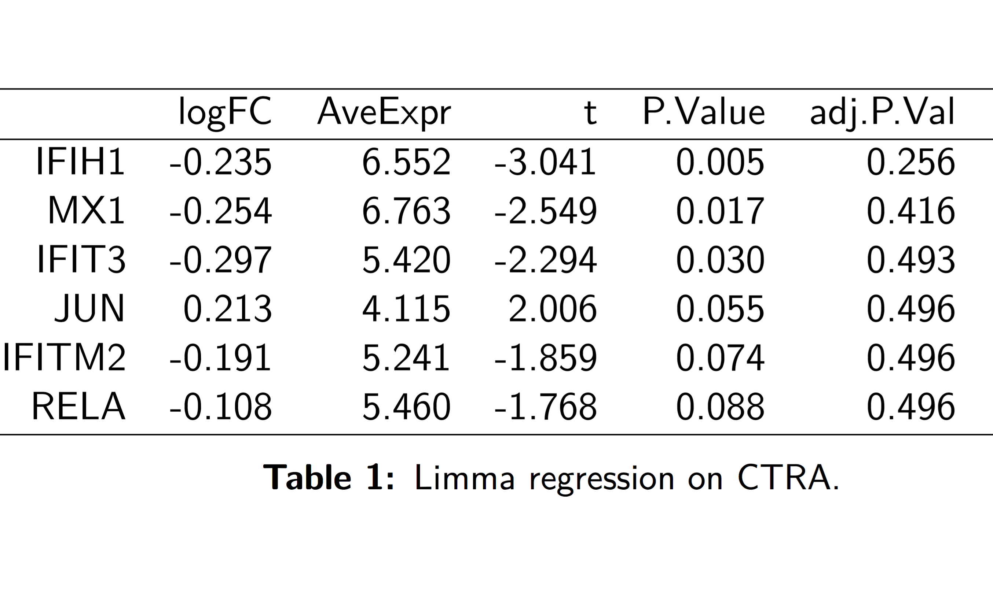
Notes:
P(G|H)

Slide 21
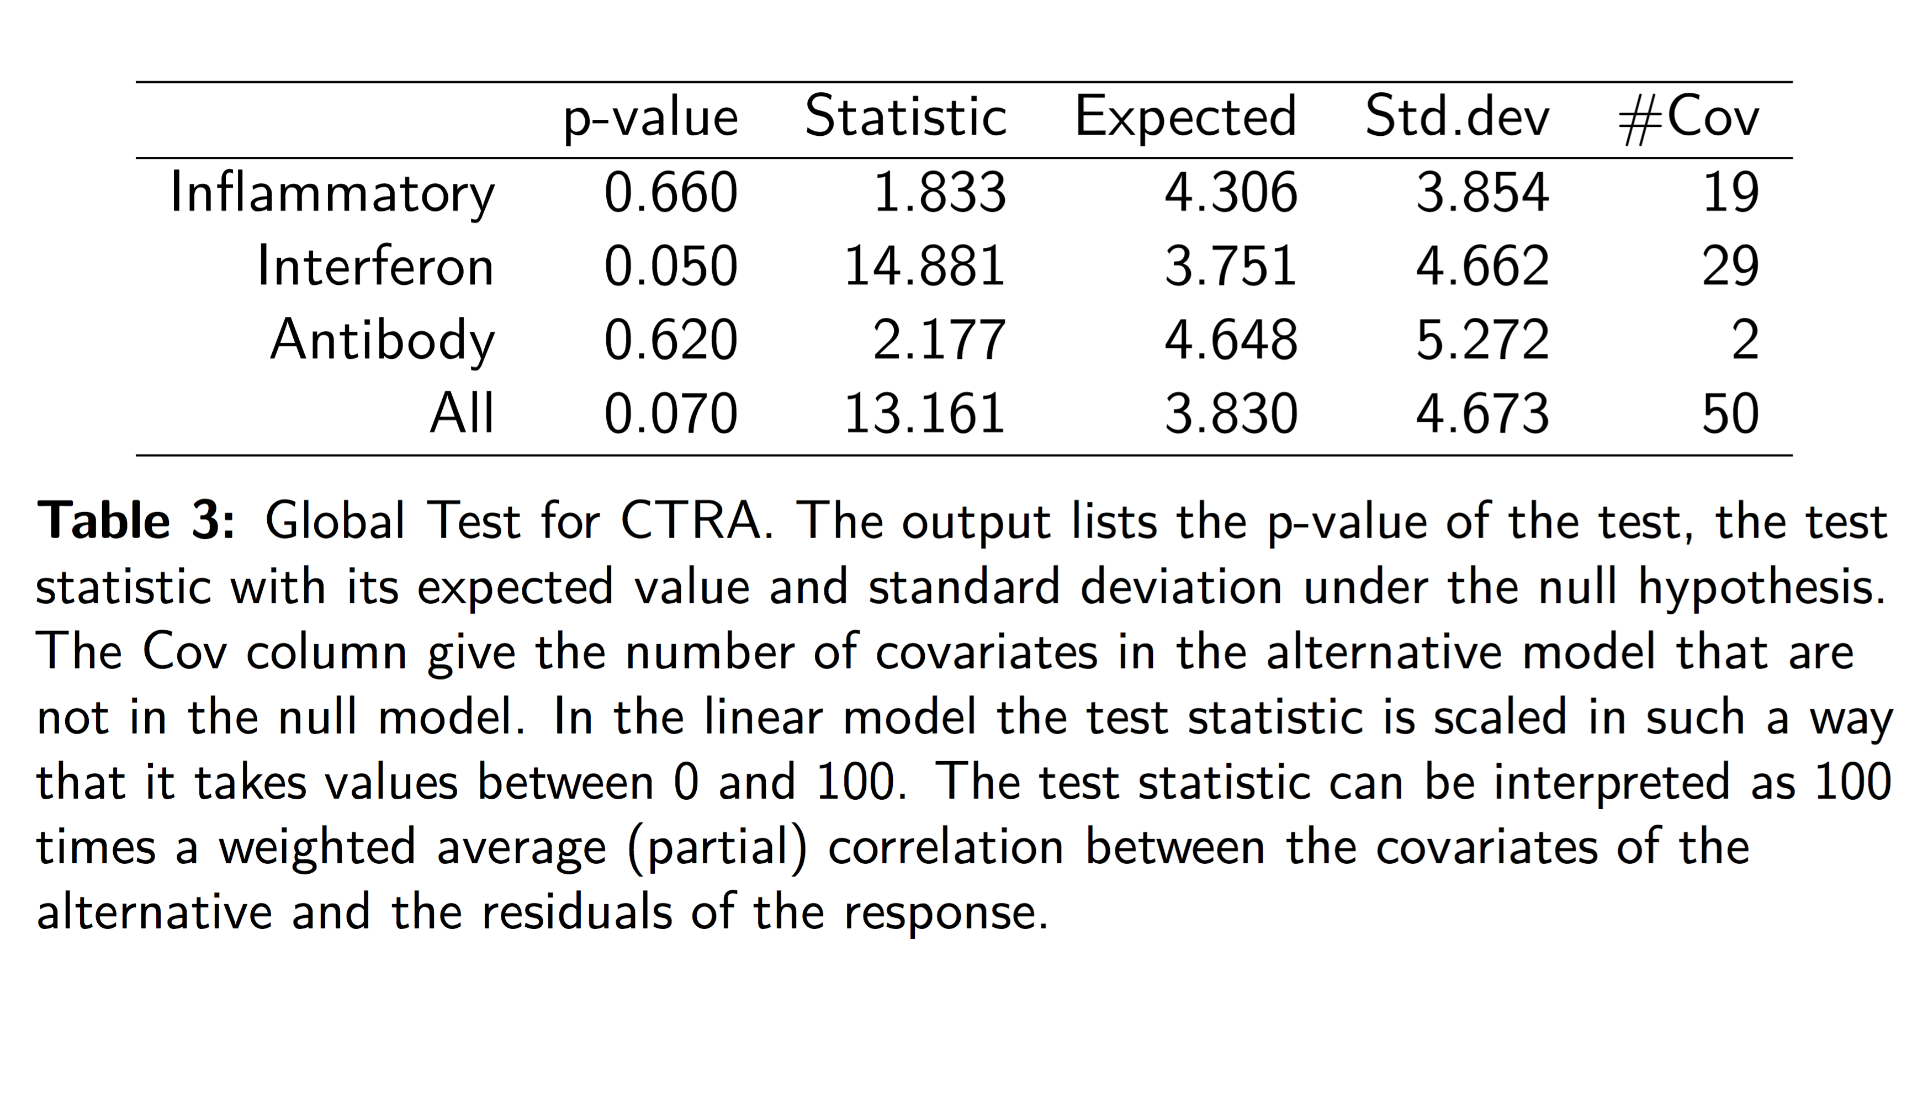
Notes:
P(T|G) Global test.

Slide 22
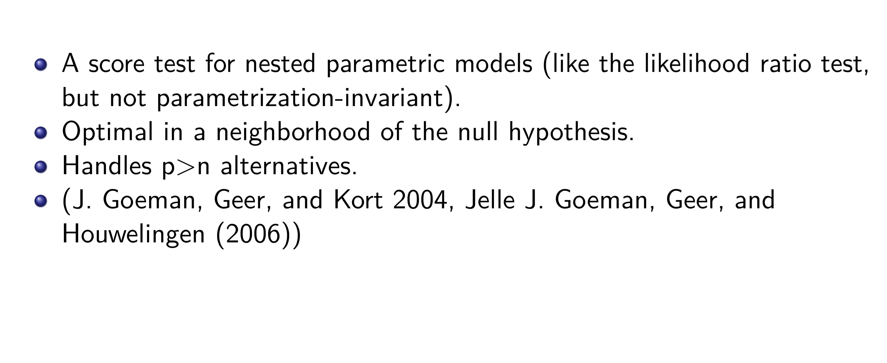
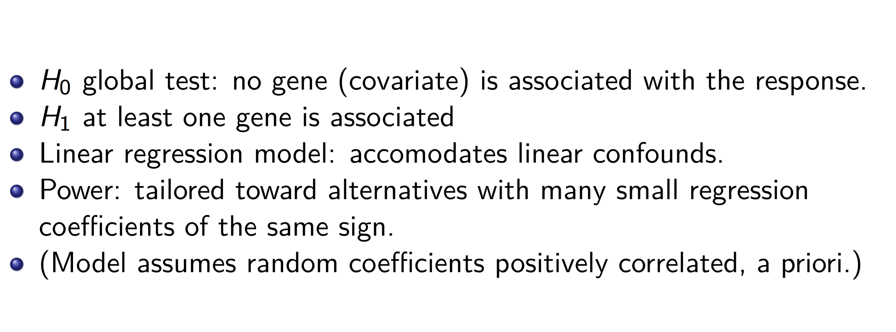
Notes:
Technicalities: global test

Slide 23
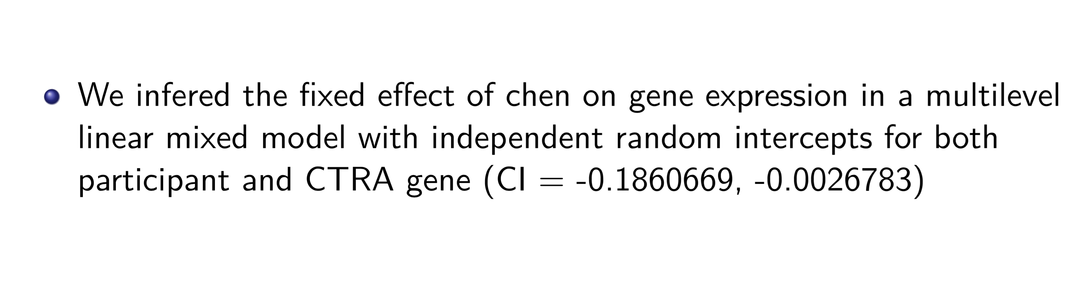
Notes:
More precision on P(H|G)

Slide 24
Y
- gene expression
- N dimensional gene expression
- cell type prevalence
- clustering coefficient
0
1
E
Cause (Noun): something that brings about an effect or a result
Effect (Noun): something that inevitably follows a … a cause
Notes:
E social, Y biological.
“Correlation doesn’t imply causation.”
Probability is fundamentally limited, symmetric: can’t express whether T is set or observed.

Slide 25
Y
Probability is symmetric.
What is missing?
Missing structure.
T
Y
0
1
T
Notes:
Dogma of causal inference.

Slide 26
Y
Probability is symmetric.
What is missing?
Missing structure.
t = g(u_{t})
y = f(t, u_{y})
T
Y
0
1
T
Notes:
Dogma of causal inference.

Slide 27
Y
Probability is symmetric.
What is missing?
Missing structure.
t = g(u_{t})
y = f(t, u_{y})
T
Y
0
1
T
Z
Variables/nodes
Included Arrows
Excluded arrows (strong exclusion restrictions)
Notes:
A functional/deterministic definition of natural assignment SEM.
Exclusion restrictions: strong causal assumptions pruned.
Exogenous action = structural changes (of exclusion restrictions) relative to natural assignment.
Post-intervention structural asymmetry.
Structure induces in/dependence, by transforming exogenous variables.
Very general, abstracts over hidden mediators (coarseness, could split causal paths ad infinitum), moderation of included variables, node domain (discrete/continuous/both).
Algorithm for DAG construction and application (backdoor).
Complete no false exclusions, no false node/edge exclusion of any common cause (check all pairs).
No unbocked backdoor.

Slide 28
Y₀
Probability is symmetric.
What is missing?
Y₁

Slide 29
Y₀
Probability is symmetric.
What is missing?
Missing counterfactual CTRA, had you not been exposed to adversity.
Y₁
Notes:
Continuous outcome variable was on the y-axis.
Binary treatment variable for each unit as a horizontal/vertical bar.
each subject could have received the other treatment (no ovary removal for men).
ceteris parabis, i.e. at the level of each individual "unit" subjected to intervention.
Potential outcomes can be viewed as a short hand notation for general structural equations (not necessarily linear or parametric). For example, take the following trivial, linear parametric structural equation model: we can abbreviate the structural causal equations CTRAi(Xi=1)=d+c+ei, and CTRAi(Xi=0)=d+ei as CTRAi(1) and CTRAi(0) respectively. Note that only one potential outcome can be observed, the other is counterfactual. Causal inference, i.e. on CTRAi(1)-CTRAi(0), thus requires identifying conditions which justify imputing the missing counterfactual. See (Pearl 2014) to explicitly compare the structural formulation of mediation side by side with the potential outcome formulation.

Slide 30
Y₀
Y_{OBS} = Y₀+(Y₁ – Y₀)T
Y₁
Notes:
Causation = missingness.
Treatment dictates the outcome, but the potential outcomes should be unrelated to treatment.
Note resulution lower than “mechanism”, sufficient component cause.
“Correlation doesn’t imply causation.”
Is this correlation causal?
All different units – not ceteris parabis, comparing chalk and cheese! Either compress or otherwise solve MCP!
Outcome is specific to this individual at this time.
Why this outcome under control condition? Rubin’s PO approach is agnostic about natural assignment (the emphasize is entirely on experimental assignment, as we will see). Conversely, one can capture the gener multivariate causal model
“The ‘population’ might contain just one individual, in which case the graph is a model for effects on that individual.”
Non-parametric definition.

Slide 31
Y₀
T
Y
These nodes are not counterfactual but observable
Y₁
Unit potential effect
0
Y₁
- Y₀
Notes:
Ceteris parabis
We want both.
Then, defn: no effect for individual i if Y_{ij} = Y_{ik} for every possible pair of treatment levels x_{j} and x_{k}; otherwise, if Y_{ij} ≠ Y_{ik} for some pair of treatment levels x_{j} and x_{k}, treatment choice could have had an effect, or could have caused a change in the actual outcome of individual i (from Y_{ik} to Y_{ij}).
The fundamental problem: in general, some background variable changes in-between. Crunch time. Time to choose.
One way of summarizing the scope of potential-outcome models is that they represent the limit of what one could learn about individual causes and effects from perfect crossover trials.
“Counterfactual analysis can be viewed as a special type of latent-variable analysis”.
Randomness is censoring/assignment.
No sampling from superpopulation.
No confounding.
No measurement error.
“The ‘population’ might contain just one individual, in which case the graph is a model for effects on that individual”

Slide 32
Y₀
T
Y
Finite sample effect
Y₁
Unit potential effect
0
Y₁
- Y₀
log(Y₁
/Y₀)
Notes:
Implies marginal pseudopopluations, the effect distribution, and the graph.
Causation defined in terms of contrasts (Rubin).
No randomness in the (distributional) estimand, except through action or ignorance.
No measurement error.
The “fundamental” problem.
Every solution needs imputation assumptions: qualitative/quantitative.
Not frequentist: no sampling/super-population.
Unit-level.
Heterogeneity.
We only see one projection of possible worlds: only observe margins.
Outcome distribution if everyone had 0, by imputation
Outcome distribution if everyone had 1, by imputation
Compare these
Pseudo population of Nx2 units.
Different estimands!
Never observed!
No randomness!
Statistical assumptions to solve this!
Motivate assumptions: knowledge of the assignment mechanism (e.g. because you own the mechanism).
Conditional unconfoundedness: means random assignment mechanism unrelated to all confounds, realizations generally are not in small samples (bad randomizations)! Unbiased over randomizations.
Like confidence intervals for the sampling mechanism.
NB. Heterogeneity and average causal effect. Causal expectation and variance
Different methods make different assumptions about heterogeneity: e.g. doesn’t exist, is parametric, is general.
Heterogeneity ruinous for mediation.

Slide 33
Y₀
T
Y
Finite sample effect
Y₁
Unit potential effect
0
Y₁
- Y₀
log(Y₁
/Y₀)

Slide 34
Y₀
T
Y
Finite sample effect
Y₁
Unit potential effect
Different estimands
0
Y₁
- Y₀
(super) population effect
log(Y₁
/Y₀)
Notes:
Sequential random sampling, assignment (then measurement).
All randomness is known in experiments.
New assumptions about super-population, sampling assumptions.
Neyman asymptotics avoids parametric population assumptions.
Is the sample representatiive of POS? Then bias FOR THE SUPERPOPULATION, even in randomized assignment.

Slide 35
Y₀
Y₁
Notes:
Forward problem defined { (Y_{0i},Y_{1i}) } holy grail.
Unit, sample, super-population estimands?
All causal inference is imputation.
Impute by hypothesis, tested under the randomization distribution
Impute by estimation: mean, bootstrap, Bayesian.
Ill-defined inverse/identification-problem. Unobserved counterfactual. Observed projection on Plato's cave. Can’t observe (Y0,Y1), cov(Y0,Y1), Y1-Y0, “Ridge” of ignorance.
Non-identification = likelihood invariance to changing “parameter” of the DGP.
Any relationship is possible between causal effects and observable data.
All causal relations logically consistent with the observed data.
A parameter is said to be identified if different parameter settings of the underlying data generating process imply different distributions over observed variables.
Statistical, parametric versus causal/conterfactual/structural identifiability. (this one doesn’t go away with n-infty, unlike p>n problems).
Assumptions permit identity/inversion between the observed data and some counterfactual parameter.
Assumptions impute (by hypothesis (Fisher)) or by mean imputation, Bootstrap, or Bayesian model (display graphs of these above?).
Assumptions needed: weak, transparent, intuitive, plausible, testable, sensitivity. (Not directly testable).
Assumptions qualitative (non-parametric) about the assignment process: exogeneity, ignorability, unconfoundedness, exclusion restrictions, backdoor, ommitted variable bias.
Assumptions written as (conditional) independence statements, themselves derivable from structural exclusion restrictions, and encoded graphically.
T _I_ Y_i | empty-set (strong)
T _I_ Y_i | X1 (weak)
T _I_ Y_i | X (weakest)
Assumption perfect crossover.
Assumptions quantitative.
Assumptions always needed - else unknown bias - even in RCTs (benefit of RCT is can check random assignment device). Randomized assignment, or natural structural assignment.

Slide 36
Y₀
T
Y
Y₁
0

Slide 37
Y₀
T
Y
Y₁
0
Notes:
Parameters of conditional potential effect distributions?
Effect of treatment on the treated.
Effect of treatment on women.

Slide 38
Y₀
T
Y
Y₁
0
Notes:
Simpson
Self-medication based on expected PO.
Selective treatment for sick patients.
Here, both sickness and drug cause the POs, in different directions. Sickness dominates here.
How does this scale with outcome dimension (eg. Gene-set)?

Slide 39
Y₀
T
T
Y
Y
Y₁
0
E(Y₁-Y₀) ≠ E(Y_{t}-Y_{c})

Slide 40
Systematic assignment selection bias: potential outcomes imbalanced across treatment groups.
Y₀
B
T
Y
Y₁
Notes:
Why pathological inference?
Short answer 1: systematic relation between treatment and the potential outcome (what would have happened anyway).
Given ineffective height drug only to men.
People who got the treatment would have a poor outcome anyway!
Propensity score deterministic and increasing.
Long answer 2:
Generative explanation: binary confound causes treatment and potential outcome.
Genetic, social confounds, neither/both.
Hetero/Homozygotes for the gene in question: basal expression differs!
“Differential expression” is an artifact of confounded treatment assignment.
Fixed (sex) a sampled strata/subject/cluster (which does not imply using RFX model, unless treatment is unrelated to potential outcomes).
Batch effects. Clustering.
Ommitted variable bias.
Simpson viewed as an underfitting bias (due to open backdoor), traded for higher variance (because more free parameters)
Artifactual (selection).
On DAGS.
Natural assignment (deterministic system yields new graph, which better exposes high-dimensional confounding).
Deterministic causation implies statistical independence when root causes are sampled.
Experimental assignment changes the structure of natural assignment, ceteris parabis.
PO + identification conditions (e.g. ignorability) derived from (exclusion set of) hypothetical multivariate model of natural assignment.
Causes of treatment and causes of potential outcome.
Conditional independence of counterfactuals versus DAG: easier!
“Natural propensity score” (from direct causes of treatment) versus “true propensity score” (from “as many covariates as possible”).
Present edges encode direct casuation, ceteris parabis (relative to the graph, for at least one combination of background variables).
Not the intervention structure.
Not the estimated/learned (markov equivalence class of) structure (doesn’t encode chance confounding due to bad randomizations etc).
Find identification conditions algorithmically, from a defensible domain knowledge.
Derive all testable assumptions of DAG.
A causal DAG is one in which 1) the arrows can be interpreted as direct causal effects (as defined in Appendix A.1), and 2) all common causes of any pair of
variables are included on the graph. Causal DAGs are acyclic because a variable cannot cause itself, either directly or through
other variables.
“Besides representing causal relations, causal DAGs also encode the causal determinants of statistical associations” (all associations are due to transforming white noise).
“The requirement that the ε_{i} be mutually independent is essentially a requirement that there is no variable absent from the graph which, if included on the graph, would be a parent of two or more variables.”
Causal DAG theory hinges on finding a set of mutually-independent root variables. The causal structure induces all correlations. All correlations come from causal structure. A generative theory of dependence structure!!
“The theory of causal DAGs then specifies that an association between an exposure and an outcome can be produced by the following 3 causal structures” (see canonical graph above!, but don’t forget measurement error).
DAG are a generalization of models from genetics! (Seewal Wright 1921) Correlation and causation.
The equations themselves represent one-step ahead counterfactuals with other counterfactuals given by recursive substitution.
We say that Z suffices to control for confounding for the estimation of the causal effect of A on Y if pr(Y_{A=a}|Z = z) = pr(Y|Z = z, A = a) for all z and a. A back-door path from some node A to another node Y is a path which begins with a directed edge into A. Pearl (1995) showed that for intervention variable A and outcome Y, if a set of variables Z is such that no variable in Z is a descendent of A and such that Z blocks all back-door paths from A to Y then conditioning on Z suffices to control for confounding for the estimation of the causal effect of A on Y.
A graph is causal if every arrow represents the presence of an effect of the parent (causal) variable on the child (affected) variable. In a causal graph, a directed path represents a causal pathway, and an X-to-Y arrow represents a direct effect of X on Y within the graph (an effect not mediated through any other variable in the graph). Each graph in Figure 1 summarizes causal relations within a population of individuals, and each variable represents the states or events among individuals in that population. For example, if X is a treatment variable, then the value of X for an individual is the level of treatment received by the iåndividual. Absence of a directed path from X to Y in the graph corresponds to the causal null hypothesis that no alteration of the distribution of X could change the distribution of Y.
The ‘population’ might contain just one individual, in which case the graph is a model for effects on that individual. Furthermore, the ‘individuals’ in the population need not be persons; they may be administrative entities, natural groupings, or any other unit of interest. For example, in a study of the effect of state helmet laws on riding-accident mortality Y among motorcyclists, the individual units could be states, X could be helmet-law status, and Z could be helmet-law enforcement levels. One could also draw an accident-level graph in which X could be helmet-law status in the accident’s locale, Z indicates whether the motorcyclist was wearing a helmet, and Y indicates whether the motorcyclist was killed.
“Causal DAGs are acyclic because a variable cannot cause itself, either directly or through other variables.”
In econometrics (?) assignment selection bias is one part of a decomposition of the observed treatment contrast ATE = ATT + SELECTION-BIAS
Elsewhere selection bias refers to SAMPLE selection bias.
Identification conditions can be expressed in diverse ways, e.g. judging conditional independencies among counterfactual variables, often called strong ignorability, conditional ignorability , or sequential ignorability, presents a formidable task without structural models. Efforts to replace ignorability vocabulary - with notions such as no unmeasured confounders, no unmeasured confounding, as if randomized, effectively randomly assigned, or essentially random - create ambiguity. First, the notion of a confounder varies significantly from author to author. Some define a confounder (say of the NP-CTRA relationship) as a variable that affects both NP and CTRA. Some define confounder as a variable that is associated with both NP and CTRA. Others allow for a confounder to affect NP and be associated with CTRA. Worse yet, the expression no unmeasured confounders is sometimes used to exclude the very existence of such confounders and sometimes to affirm our ability to neutralize them by controlling other variables, not necessarily confounders. Second, the interpretations have taken sequential ignorability as a starting point and consequently are overly stringent – sequential ignorability is a sufficient but not necessary condition for identifying natural effects. Weaker conditions can be articulated in a transparent and unambiguous language which provide a greater identification power and a greater conceptual clarity.

Slide 41
Y₀
Natural propensity
1
1
1
B
1
1
0
0
T
Y
0
0
0
Y₁

Slide 42
Y₀
B
T
Y
Y₁
Continuous covariate.

Slide 43
Y₀
1
1
1
1
1
c
0
0
T
Y
0
0
0
c
Y₁
S = 1_{(T + Y > c)} = 1
Notes:
If unknown to us, or if this is just one strata/subpopulation of S of our data, this sample only contains T + Y > c
Then observed Y < c (beneath threshold) must come from T = 1 (cannot be beneath threshold).
Berkson: T = Talented academic, Y = running speed.
So, “must not stratify by variables affected by treatment”
In fact this is necessary, but not sufficient (c.f. Pearl).

Slide 44
Y₀
1
1
1
1
1
c
0
0
Backdoor theorem
0
0
0
c
Y₁

Slide 45
Identification
Randomization
Conditioning
Instrumental variables
Inverse-probability

Slide 46
Y₀
Y₁
Notes:
Solution?
a) One assumption which guarentees no relation on average is to randomize: ensures that treatment is independent of EVERYTHING.
Want balance/orthogonality/independence of treatment with all un/observed causes of outcome.
Improbable under if assignment random so independent of everything (exclusion restrictions of the dice).
Thus in born the RCT. 1) Zero average causal effect is not zero causal effect.
Fisher trades something you don’t know (natural assignment) for something you do (experimental assignment mechanism).
Independence addresses bias (of ATE: E(Y_t) = E(Y_1) , etc), re-randomization addresses variance.
Test statistic distribution only reflects induced randomization, that would be induced
by the experimentation mechanism.
Attempts to address spurious overfitting (of treatment to an unobserved cause of PO) to a specific random realization.
2 ways to get wrong answer. Systematic bias and random variance. As n to infty the second diminishes.
--
Fishers null counterfactual imputation.
Under sharp point null
- all counterfactuals known (on the line).
Under RCT
assignment mechanism independent of everything, including the POs, so T _| Y_t
propensity scores known.
Use the randomization distribution used for actual assignment, to rerandomize.
Falsify this imputation.
Ave_y_t- Ave_y_c is specific to (overfits) the particular assignment vector w (varies over assigments), while the estimand is constant.
aveY_t – aveY_c denotes this change over the randomization distribution of assignments.
Solution: control and/or randomize.
Improbable under if assignment random.
Chance increases with outcome dimension: the multiple comparison problem/overfitting/type-I: solutions regularization, pooling, averaging/gene-sets,…
Fishers proof by contradicting assumptions used to derived the null distribution,
i.e. “sharp” null imputation + randomization assumptions.
If the randomization is known and the imputation is known, then so is the distribution of the test statistic.
P-value is not an estimate, it’s variibility is not relevant. It is not predictive, it does not pertain to “reproducibility”.
Fixed estimand, random estimator.
Fishers proof by contradiction: addresses both chance and systematic confounding. Introduces (known) variance to eliminate (unknown) bias.
P(T) , H0 -> p(observable-test-statistic)

Slide 47
Y₀
Y₁

Slide 48
Counterfactual gene expression.
Actual observed gene expression.

Slide 49
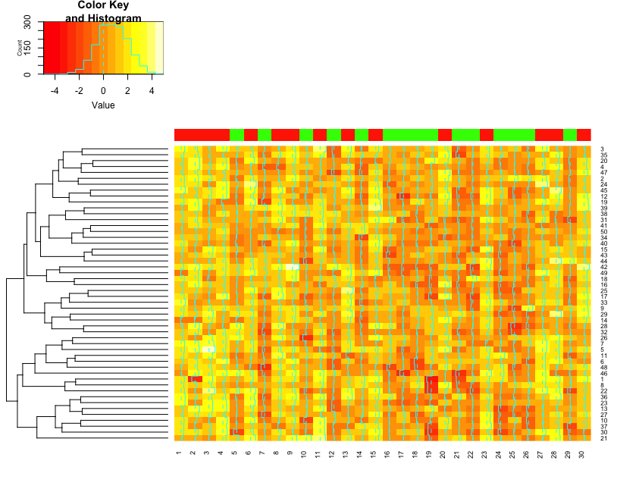
Counterfactual gene expression
under Fishers sharp imputation.

Slide 50
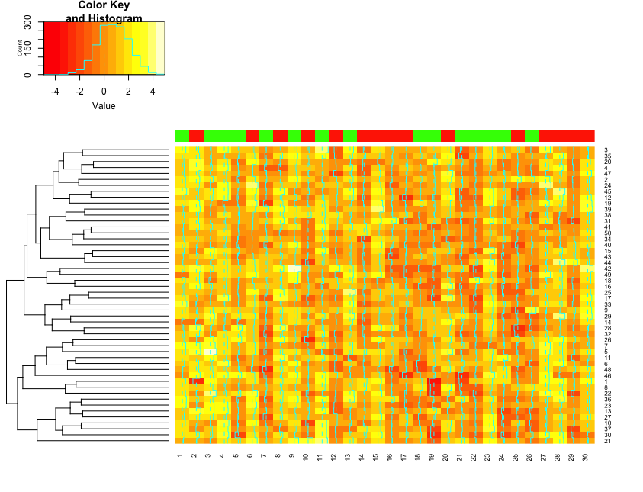
Stochastic proof by contradiction.
Gene-level (DE, MCP)
Set-level (MCP if multiple sets)
Network-level

Slide 51


Slide 52


Slide 53


Slide 54
Variants
Fisher’s finite-sample
Neyman/Rubin super-population
interval estimation requires additional assumptions beyond what is required for testing the causal null hypothesis
etc, …

Slide 55
Identification
Randomization
Conditioning
Instrumental variables
Inverse-probability
{X : T (Y₀, Y₁) | X}
{X : T (Y₀, Y₁) | e(X)}

Slide 56
Y₀
B
T
Y
Y₁
Notes:
Solution.
b) “Control” perfect crossover/ceteris-parabis (between treat/control units, i.e. Identical/matched potential outcomes).
“Control” removes bias by removing variation in the PO across treated units, blocking variation in confounders.
In general, blocking reduce variance and bias (blocking on treatment-independent and treatment-dependent causes of the PO respectively i.e. factors that effect outcome, even had treatment been fixed).
Here bias/consistency trumps variance/efficiency.
a) Match on categorical/cluster/batch/strata dummy/intercept effects – “fixed effect” - stands in for an unknown set of factors that vary across clusters - and cause variation in the joint potential outcome - but are assumed homogenous within strata/cluster.
Group units into clusters with homogenous/constant/comparable potential effects (ceteris parabis) and observe both.
Batch/strata/slice/block = set the value of a variable that effects POS.
But how do you know which units are PO homogenous (PO unobserved)? Need knowledge!
Encode this knowledge with a DAG.
b) Match on continuous variables which affect outcome (then don’t need to stratify on cluster category/dummy?).
“Fixed effect” Imperative to fix strata at odds with random strata effects model.
Cluster indexed confounding (clusters move up the diagonal have different assignment probabality) “second-level confounds” violate standard MLM assumptions.
Cluster indexed heterogeneity (clusters move orthogonal to the diagonal); can use a multilevel random coefficients model if no subject-treatment confounding, e.g. in a perfect crossover setting within cluster/group/subject. Then, for example, intra-class coefficient (i.e. intra-cluster mutual information) is just one population estimand from MLM, also regularized intra-class effects themselves.
Stratify/block on cluster/group/strata/”fixed effect” to block backdoor (if strata-treatment confounding), or to do variance decomposition (within versus between strata, e.g. Quantified by intra-class correlation), or to explain between strata variation based on second-level predictors (but only do these if no confounding). Can use shrinkage here.

Slide 57
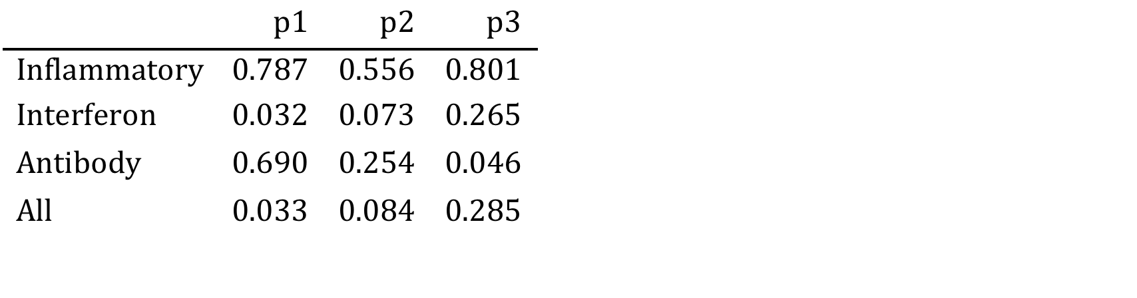
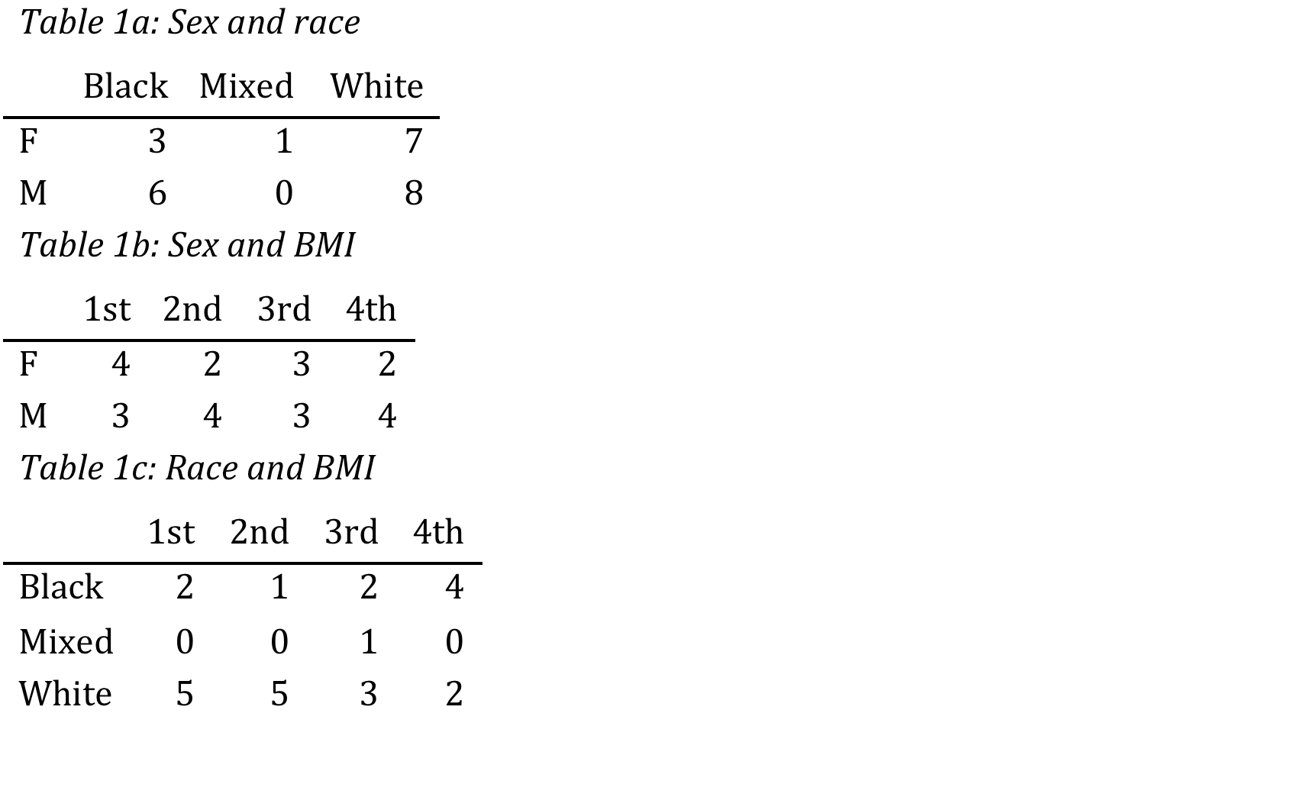
= (sex, race, bmi)
B
T
Y
M
C
Table 2: Our analysis of the relation between Chen, the CTRA gene set and its component subsets, with and without covariate adjustment (see Q1). This table presents p-values from a global score test on a hyperparameter in an empirical Bayesian model, and is an alternative to classical tests of a point null hypothesis against a high dimensional alternative, even when the number of genes exceeds the number of samples. This test has optimal expected power in the neighbourhood of the null hypothesis. We used a permutation null distribution which requires the assumption that there is no relationship between gene expressions on the one hand, the covariates (bmi, sex and race) and the censoring mechanism on the other hand: permuting destroys these associations. The main advantage of the permutation-based P-value is that it gives an ‘exact’ P-value, which is guaranteed to keep the alpha level provided enough permutations are used. This is especially useful for smaller sample sizes like ours, where we may not trust the normality of the distribution of our score statistic. Note that a significant global test does not mean that every interferon gene is associated with Chen. It means that the subjects with similar Chen have relatively similar CTRA interferon expression profile. It also means that there is potential to predict Chen from interferon gene expression.
Notes:
Non-RCT
Ignorability sufficient (RCT unnecessary)
Conditions!?
Backdoor identification conditions via d-separation algorithm (about bias not variance)
Block natural (and avoid artifactual) confounding

Slide 58
Reality check

Slide 59
Y
Proximal/distal
Environmental
Brain
Cognitive
Molecular – KEGG DAG/TELIS
M
T
Y
0
1
T
Notes:
stratification doesn’t work
Mediation + feedback
Confounders affected by prior treatment - both confounders and mediators- called “time-dependent confounds” in epidemiology.
The standard regression approach to mediation analysis in randomized trials assumes sequential ignorability of the mediator, that is that the mediator is effectively randomly assigned given baseline covariates and the randomized treatment. Since the experiment does not randomize the mediator, sequential ignorability is often not plausible.
Alternatives to sequential ignorability.

Slide 60
Y_{0,M0}
M
T
Y
Y_{0,M1}
Natural variation in response of M to treatment, across units.
Notes:
New identification issues.
Natural indirect effect never observed.
Heterogeneity more important now.

Slide 61
M
Exclusion restrictions.
RCT assumptions not enough.
Heterogeneity.
T
Y

Slide 62
C₃₁₁
M
Exclusion restrictions.
RCT assumptions not enough.
T
Y

Slide 63
C₃₁₁
M
Exclusion restrictions.
Sequential ignorability.
RCT assumptions not enough.
Sequential ignorability.
T
Y
Assume,
Y = C₃₁₁
M = T + C₃₁₁
Adjusted treatment effect.
Compare T = 0/1 for matched units M = 0.
Y = C₃₁₁ = M - T = 0
Y = C₃₁₁ = M - T = -1
Notes:
Statistically "controlling" for M in the analysis (by including M in the regression equation) does not physically disable the paths going through M ; it merely matches samples with equal M values, and thus induces spurious correlations among other factors in the analysis, see (Pearl 2014). This can be readily shown using classical path-tracing rules.

Slide 64
C₂₁₂
C₃₁₁
M
T
Y
C₁₁₁

Slide 65
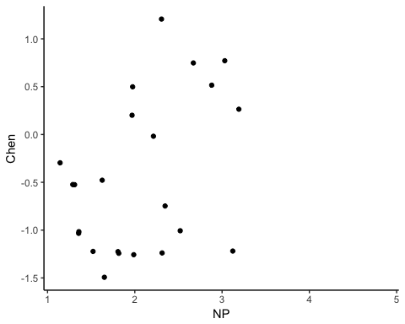
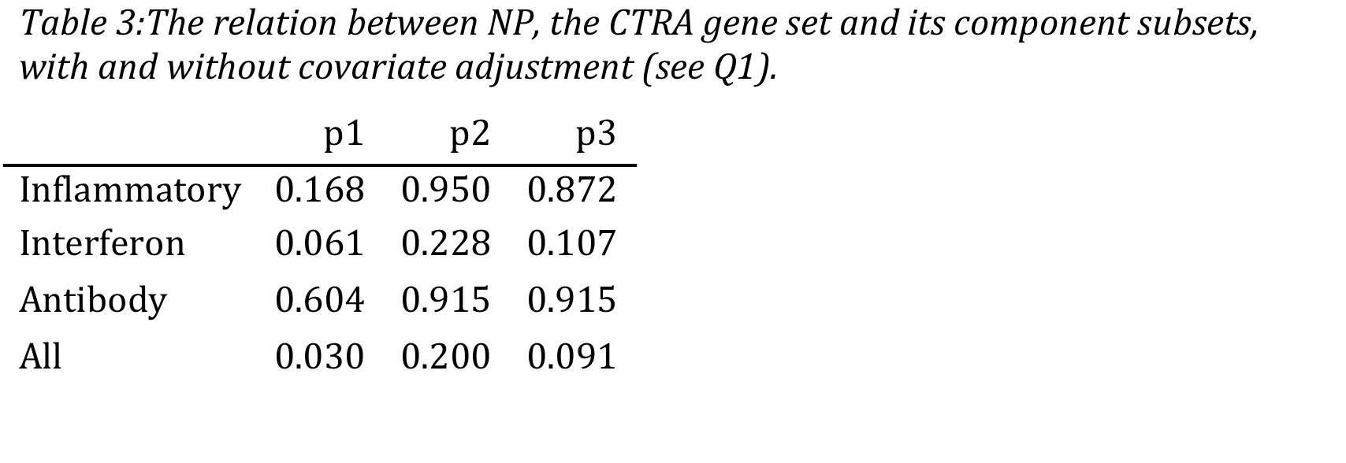
C₃₁₁
M
T
Y
marginals

Slide 66
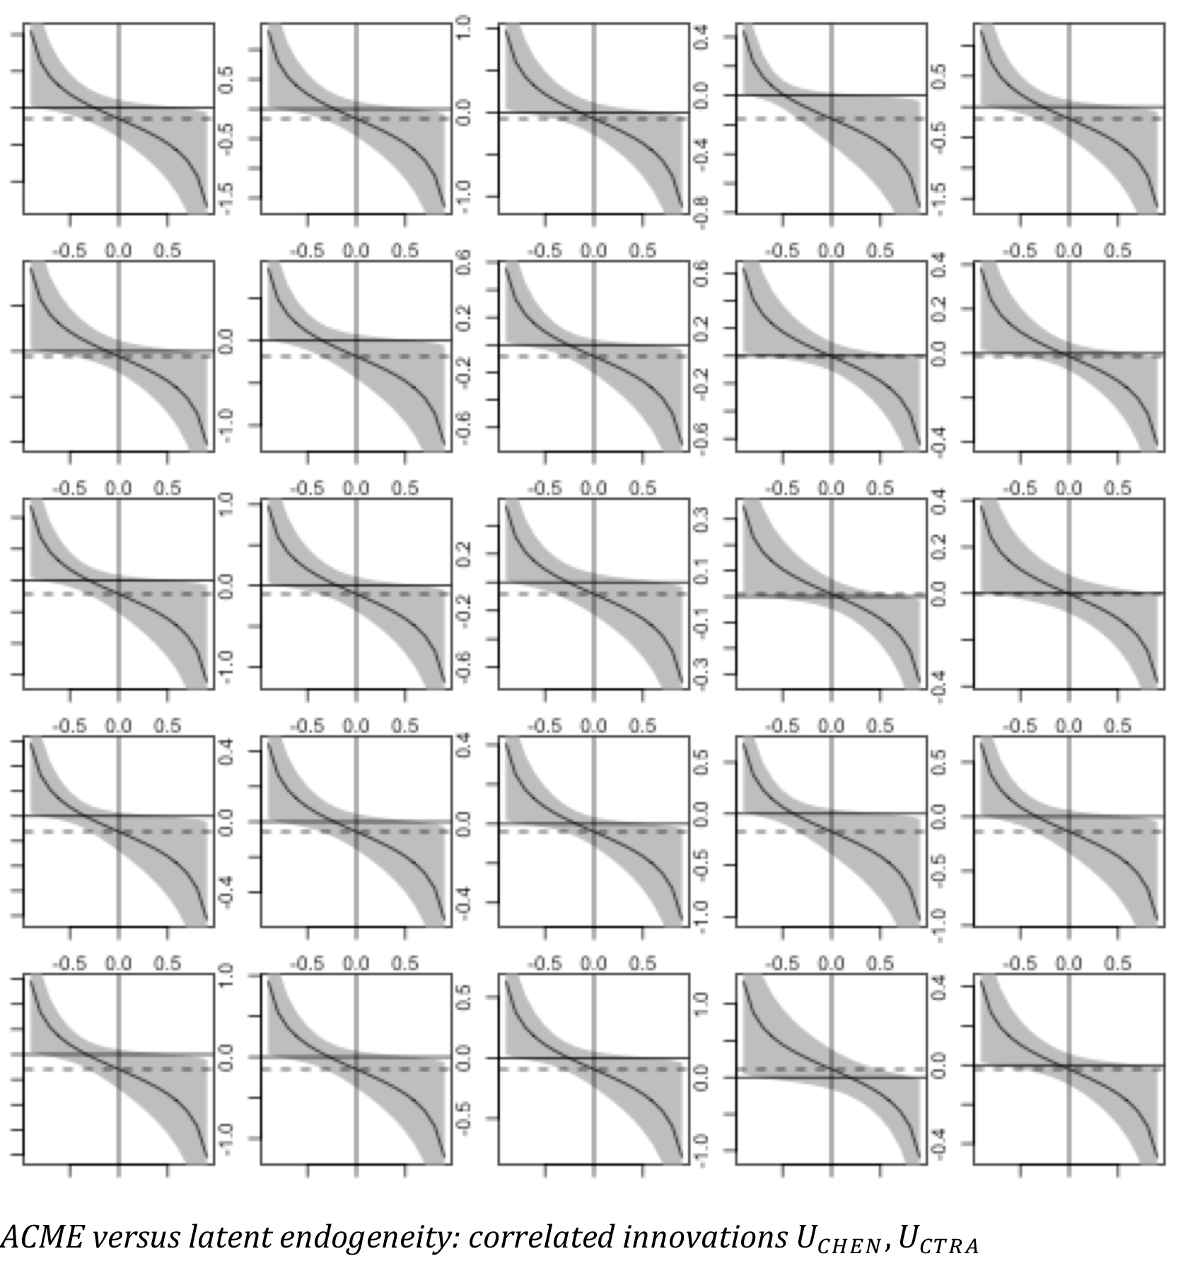
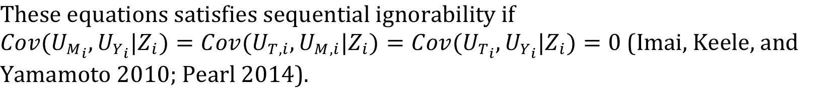

C₃₁₁
M
T
Y

Slide 67
Reality check
Mediation in feedback systems
Beyond conditioning
Omitted confounds
No treatment variation within-strata
Artifactual selection (marginal structural models, etc).
Methods from life-course epidemiology, statistics, engineering….
Marginal structural causal models
Causal structure learning.

Slide 68
Thank you
Notes:
Bias generally in terms of expected difference between a random estimator, and a constant estimand.
In causal inference, that estimand is causal.

Slide 69
Information box: Defining and representing causation
Modern definitions of total, and path-specific effects - direct and indirect - are general, and not tied to any specific statistical model.
A causal variable is defined as any variable which changes the potential outcome of another variable. This idea can be interpreted as follows. First suppose we know the equations which dictate the natural directions of causation between variables in some system. Next override the equation governing one focal variable, and instead switch this variable between two different values. By definition, this focal variable is a cause of any variable which responds to this intervention (through the remaining equations). The difference between these definitions is purely notational; potential outcome definitions can easily be converted to structural definitions. Potential outcomes can be viewed as a short hand notation for general structural equations (not necessarily linear or parametric). For example, take the following trivial, linear parametric structural equation model: we can abbreviate the structural causal equations $CTRA_{i}(X_{i}=1)=d+c+e_{i}$, and $CTRA_{i}(X_{i}=0)=d+e_{i}$ as $CTRA_{i}(1)$ and $CTRA_{i}(0)$ respectively. Note that only one potential outcome can be observed, the other is counterfactual. Causal inference, i.e. on $CTRA_{i}(1)−CTRA_{i}(0)$, thus requires identifying conditions which justify imputing the missing counterfactual. See (Pearl 2014) to explicitly compare the structural formulation of mediation side by side with the potential outcome formulation.
Causation is defined ceteris parabis, i.e. at the level of each individual "unit" subjected to intervention. Various statistical methods aim to infer population parameters of these unit-level causal effects, such as propensity score matching and nearest-neighbor matching (which often uses the Mahalanobis metric, also called Mahalanobis matching), attempt to correct for the assignment mechanism by finding control units similar to treatment units on variables which confound causal effects (implied by ceteris parabis).

Slide 70
Information box: what is identification?
A parameter is said to be identified if different parameter settings of the underlying data generating process imply different distributions over observed variables. This identifiability - or lack thereof - is not a statistical problem related to the challenges of statistical inference with small samples. Pearl (2009) provides one way to think about identification. Dependence between observed variables reflects some unknown mix of causal and noncausal ("backdoor") effects. A causal effect is identified when the observed association can been adjusted somehow to remove these noncausal components. For nonparametric identification, the analyst would describe the set of assumptions that will allow us to identify a causal effect without any distributional or functional form assumptions.
To take a famous example, randomized treatment and the SUTVA identification (Rubin 1974) together nonparametrically identify the average total effect. To identify the indirect and direct effects, additional assumptions are necessary, e.g. "sequential ignorability".
Causal identification assumes the investigator has domain knowledge to judge the plausibility of no confounding type of assumptions which underly all mediation methods, whether under the rubric of sequential ignorability (e.g., Imai et al., 2010b), uncorrelated error terms, or graphical criterea. The assumptions identifying mediation can be stated most succinctly in the latter.
Identification conditions can be expressed in diverse ways, e.g. judging conditional independencies among counterfactual variables, often called strong ignorability, conditional ignorability , or sequential ignorability, presents a formidable task without structural models. Efforts to replace ignorability vocabulary - with notions such as no unmeasured confounders, no unmeasured confounding, as if randomized, effectively randomly assigned, or essentially random - create ambiguity. First, the notion of a confounder varies significantly from author to author. Some define a confounder (say of the NP-CTRA relationship) as a variable that affects both NP and CTRA. Some define confounder as a variable that is associated with both NP and CTRA. Others allow for a confounder to affect NP and be associated with CTRA. Worse yet, the expression no unmeasured confounders is sometimes used to exclude the very existence of such confounders and sometimes to affirm our ability to neutralize them by controlling other variables, not necessarily confounders. Second, the interpretations have taken sequential ignorability as a starting point and consequently are overly stringent – sequential ignorability is a sufficient but not necessary condition for identifying natural effects. Weaker conditions can be articulated in a transparent and unambiguous language which provide a greater identification power and a greater conceptual clarity.

Slide 71
Information box: Alternatives to sequential ignorability conditions for identification
Instrumental variables offer a very different answer from a causal mediation analysis (Keele 2015). Mechanisms based on IV have the advantage that one can allow for the possibility of unobserved confounding between the mediator and the outcome. However, to identify the indirect effect, one must assume that the direct effect is zero. The assumption that the direct effect is zero is widely referred to as the exclusion restriction (Angrist, Imbens, & Rubin, 1996). Thus, one must assume that there is only an indirect effect, which implies that the effect of the treatment is entirely mediated. Under this form of mechanism, we must assume that the effect of a NP only works through Chen: There cannot be any other mechanisms for the intervention.
Statistically "controlling" for M in the analysis (by including M in the regression equation) does not physically disable the paths going through M ; it merely matches samples with equal M values, and thus induces spurious correlations among other factors in the analysis, see (Pearl 2014). This can be readily shown using classical path-tracing rules. Such dependence cannot be detected by statistical means, so theoretical knowledge must be invoked to identify the sources of these correlations and control for common causes (so called "confounders") of M and CTRA whenever they are observable. This approach to mediation has two major drawbacks. One (mentioned above) is its reliance on the untested assumption of uncorrelated errors, and the second is its reliance on linearity and, in particular, on a property of linear systems called effect constancy (or no interaction): The effect of one variable on another is independent of the level at which we hold a third. This property does not extend to nonlinear systems; in such systems, the level at which we control M would in general modify the effect of T on CTRA. For example, if the output CTRA requires both T and M to be present, then holding M at zero would disable the effect of T on CTRA , while holding M at a high value would enable the latter.

Slide 72
Information Box: Modern mediation
Although one could define mediation statistically, we follow the causal definition.
The conventional mediation analysis entails fitting a set of linear regression models: ``mediation effects'' are defined in terms of these estimated model parameters. One problem with defining mediation in terms of statistical changes induced by adding a third mediator variable into a regression equation, is that mediation is inherently a causal notion hence should not be defined in statistical terms. Modern approaches therefore define mediation in terms of potential outcomes, or equivalently causal graphs. In the language of the latter, a mediator is then an intermediate variable that lies on the causal path from the treatment to the outcome. This definition is grounded in the notion of a causal path and emphasizes the difference between "fixing a variable" and "statistically adjusting for" (conditioning on) a variable as in regression.
To illustrate our measure of ACME more formally, consider a binary measure of negative parenting, a variable we call $t$ which takes 0 or 1. We will now define indirect effect of NP - via mediator Chen $M$ - within the modern framework. $M_{i}(t)$ is the effect of NP on Chen for subject $i$ under treatment (NP) status $t$. Let $CTRA_{i}(t,m)$ denote the potential outcome if NP and Chen took values $t,m$ respectively. We only observe one of these potential outcomes $CTRA_{i}(t_{i},M_{i}(t_{i}))$, where $M_{i}(t_{i})$ is the observed value of Chen at the observed NP level $t_{i}$. $CTRA_{i}(t,M_{i}(t))$ is the effect of $t$ on CTRA, which in general and be transmitted both indirectly, through $M_{i}(t)$, and "directly" (i.e. not through M but possibly through some independent mediators). Let the total causal effect for unit (subject) $i$ be
$τ_{i}=CTRA_{i}(1,M_{i}(1))−CTRA_{i}(0,M_{i}(0))$
and the unit-level indirect effect be
$δ_{i}=CTRA_{i}(t,M_{i}(1))−CTRA_{i}(t,M_{i}(0))$.
This latter relates to the following counterfactual question: how would CTRA change in this indidividual if we were to physically (counterfactually) change Chen's value under $t=0$ (no negative parenting) to that under $t=1$ (negative parenting), while keeping NP at its observed value $t$? Because these two values of Chen would naturally occur as responses to changes in NP, this quantity formalizes the notion of a causal mechanism that the causal effect of the treatment is transmitted through changes in the mediator of interest. Similarly, we define the unit direct effect, corresponding to all other possible causal mechanisms (sometimes refered to en masse as the "direct effect"), as:
$γ_{i}=CTRA_{i}(1,M_{i}(t))−CTRA_{i}(0,M_{i}(t))$.
The counterfactual question here is: how would CTRA respond to NP change $T_{i}=0$ to $T_{i}=1$, if (counterfactually) Chen was held constant? Mediation analysis creates an identification problem. The quantity $CTRAi(1,M_{i}(0))$, for example, is unobservable, but to estimate the mediation effect we need assumptions which link this unobserved counterfactual to observed quantities. We examine these assumptions. Such definitions can easily be extended to continuous treatments (NP not binary) (Imai, Keele, and Yamamoto 2010).

Slide 73
Some references
Baron, Reuben M, and David A Kenny. 1986. “The Moderator-Mediator Variable Distinction in Social Psychological Research: Conceptual, Strategic, and Statistical Considerations.” Journal of Personality and Social Psychology 51 (6): 1173–82. http://webcom.upmf-grenoble.fr/LIP/Perso/DMuller/GSERM/Articles/Journal of Personality and Social Psychology 1986 Baron.pdf.
Bolstad, B M, R A Irizarry, M Astrand, and T P Speed. 2003. “A comparison of normalization methods for high density oligonucleotide array data based on variance and bias.” Bioinformatics 19 (2): 185–93. http://www.stat.berkeley.edu/bolstad/normalize/.
Bullock, John G., Donald P. Green, and Shang E. Ha. 2010. “Yes, but what’s the mechanism? (don’t expect an easy answer).” Journal of Personality and Social Psychology 98 (4). American Psychological Association: 550–58. doi:10.1037/a0018933.
Goeman, Jelle J, and Peter Bühlmann. 2007. “Analyzing gene expression data in terms of gene sets: methodological issues.” Bioinformatics (Oxford, England) 23 (8). Oxford University Press: 980–7. doi:10.1093/bioinformatics/btm051.
Goeman, Jelle J., Sara A. van de Geer, and Hans C. van Houwelingen. 2006. “Testing against a high dimensional alternative.” Journal of the Royal Statistical Society: Series B (Statistical Methodology) 68 (3). Blackwell Publishing Ltd: 477–93. doi:10.1111/j.1467-9868.2006.00551.x.
Greenland, Sander, and James M Robins. 1986. “Identifiability, Exchangeability, and Epidemiological Confounding.” International Journal of Epidemiology 15 (3): 413–19. doi:10.1093/ije/15.3.413.
Imai, Kosuke, Luke Keele, and Teppei Yamamoto. 2010. “Identification, Inference and Sensitivity Analysis for Causal Mediation Effects.” Statistical Science 25 (1): 51–71. doi:10.1214/10-STS321.
Irizarry, Rafael A, Benjamin M Bolstad, Francois Collin, Leslie M Cope, Bridget Hobbs, and Terence P Speed. 2003. “Summaries of Affymetrix GeneChip probe level data.” Nucleic Acids Research 31 (4). Oxford University Press: e15. http://www.ncbi.nlm.nih.gov/pubmed/12582260.
Kaufman, Jay S, Richard F Maclehose, and Sol Kaufman. 2004. “A further critique of the analytic strategy of adjusting for covariates to identify biologic mediation.” Epidemiologic Perspectives & Innovations 1 (4). doi:10.1186/1742-5573-1-4.
Keele, Luke. 2015. “Causal Mediation Analysis.” American Journal of Evaluation 36 (4). SAGE PublicationsSage CA: Los Angeles, CA: 500–513. doi:10.1177/1098214015594689.

Slide 74
Kraemer, Helena, Eric Stice, Alan Kazdin, David Offord, and David Kupfer. 2001. “How Do Risk Factors Work Together? Mediators, Moderators, and Independent, Overlapping, and Proxy Risk Factors.” Am J Psychiatry 1586 (158): 848–56. http://ajp.psychiatryonline.org/doi/pdf/10.1176/appi.ajp.158.6.848.
MacKinnon, David P., Chondra M. Lockwood, Jeanne M. Hoffman, Stephen G. West, and Virgil Sheets. 2002. “A comparison of methods to test mediation and other intervening variable effects.” Psychological Methods 7 (1). American Psychological Association: 83–104. doi:10.1037/1082-989X.7.1.83.
Pearl, Judea. 2009. “Causal inference in statistics: An overview.” Statistics Surveys 3: 96–146. doi:10.1214/09-SS057.
———. 2014. “Interpretation and identification of causal mediation.” Psychological Methods 19 (4): 459–81. doi:10.1037/a0036434.
Preacher, Kristopher J., and Andrew F. Hayes. 2004. “SPSS and SAS procedures for estimating indirect effects in simple mediation models.” Behavior Research Methods, Instruments, & Computers 36 (4). Springer-Verlag: 717–31. doi:10.3758/BF03206553.
Rubin, Donald B. 1974. “Estimating causal effects of treatments in randomized and nonrandomized studies.” Journal of Educational Psychology 66 (5): 688–701. doi:10.1037/h0037350.
Smyth, Gordon, Natalie Thorne, and James Wettenhall. 2005. “Limma: linear models for microarray data.” In Bioinformatics and Computational Biology Solutions Using R and Bioconductor., 397–420. Springer New York.
Sobel, Michael E. 1982. “Asymptotic Confidence Intervals for Indirect Effects in Structural Equation Models.” Sociological Methodology 13: 290. doi:10.2307/270723.
Subramanian, Aravind, Pablo Tamayo, Vamsi K Mootha, Sayan Mukherjee, Benjamin L Ebert, Michael A Gillette, Amanda Paulovich, et al. 2005. “Gene set enrichment analysis: a knowledge-based approach for interpreting genome-wide expression profiles.” Proceedings of the National Academy of Sciences of the United States of America 102 (43). National Academy of Sciences: 15545–50. doi:10.1073/pnas.0506580102.

